Slide 1
Cattle Farming Management System Project Idea pitching
Supervised By: Mr. Muhammad Azeem

Slide 2
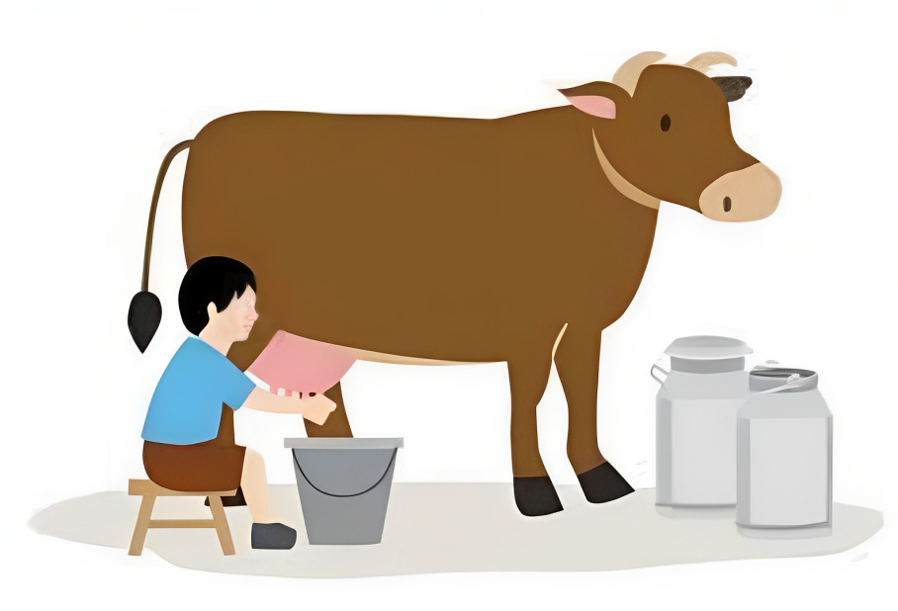
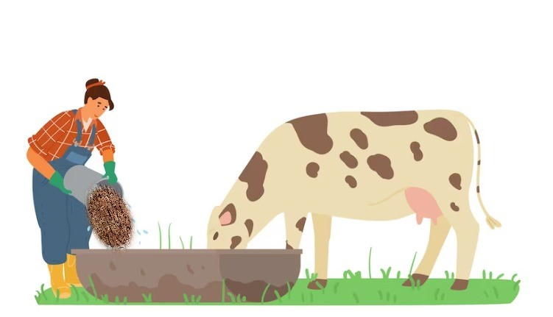
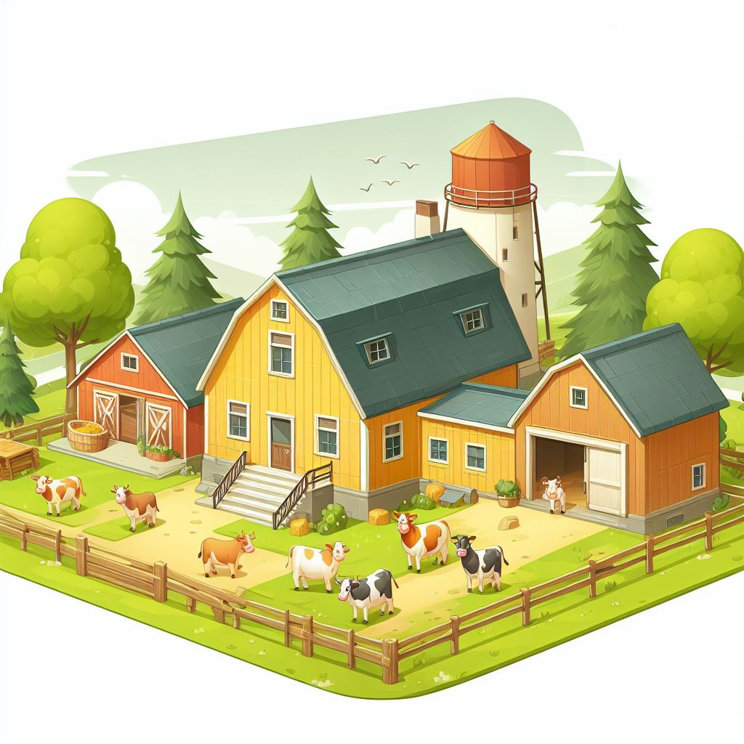

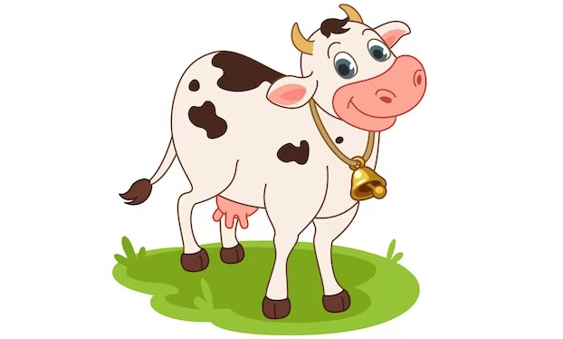
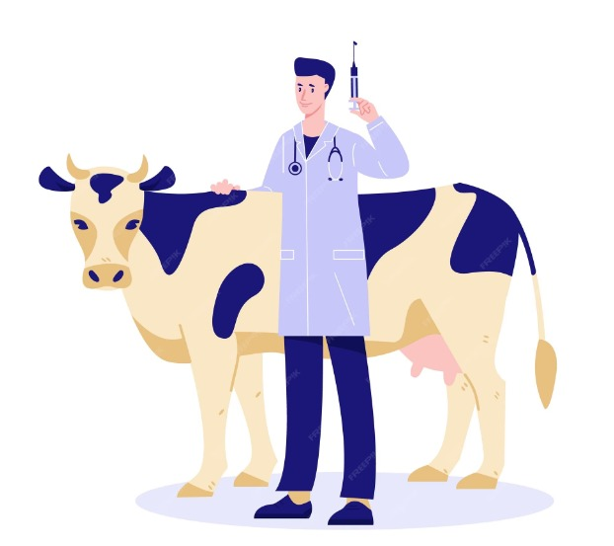
Availability issue:
Milk
Milk Record
Monitor Food
Food
Cattle Sale
Manager
Cattle
Track Vaccination
Cattle Farm
Vaccination

Slide 3



Availability issue:
Request for my Record
Wait let me check the Record
I cant find the Record
Customer
Manager
Cattle Farm

Slide 4



Slide 5

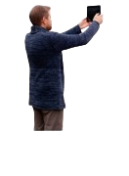
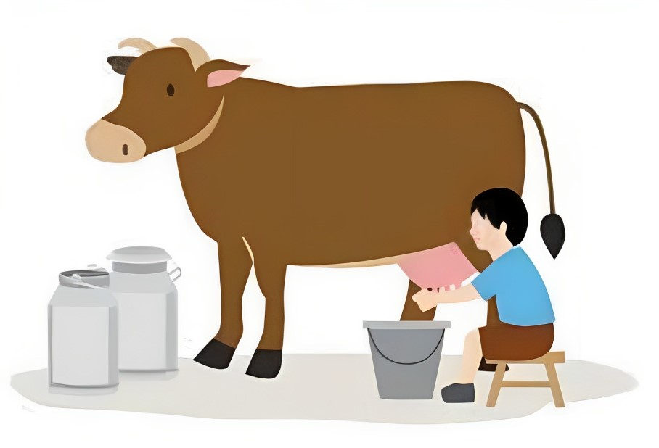
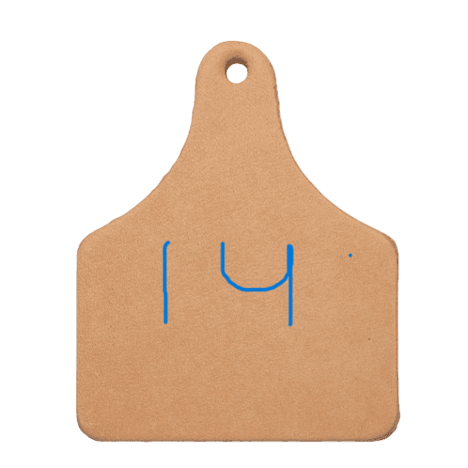
Our Idea:
After scanning tag app will show cattle milk record
Tag : 14
Gender: Female
Age: 5 year
Morning Milk:7KG
Milk Production Record
Worker
Cattle Farm
Manager
Milk

Slide 6
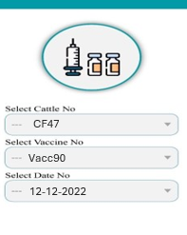

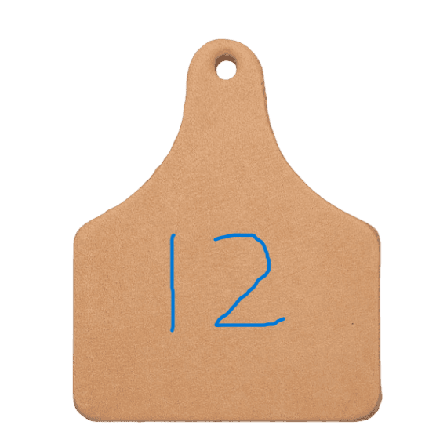
Our Idea:
Vaccination Record
Cattle Farm
Our App
Worker
Vaccination

Slide 7
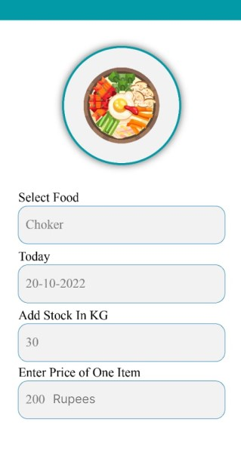

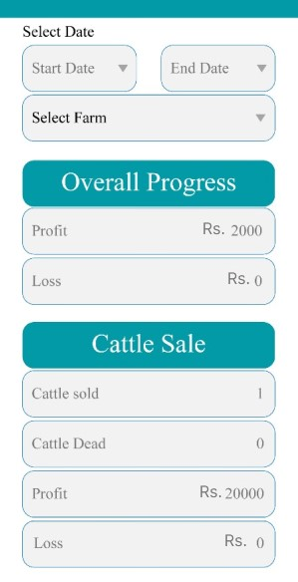
Our Idea:
Food
Cattle Farm
Our App
Manager
Transactions

Slide 8


